Slide 1
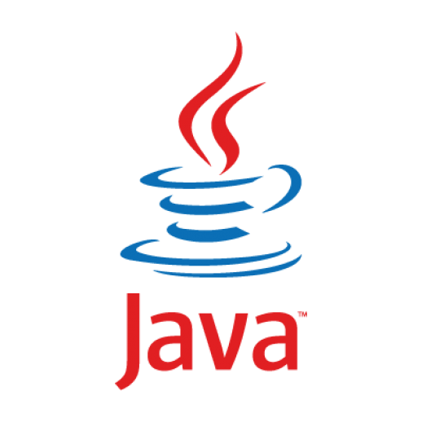
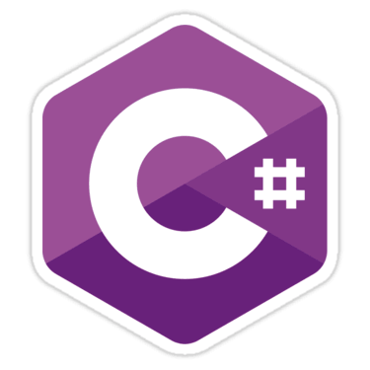



Language Comparison
Java, C#, Python and JavaScript
SoftUni Team
Technical Trainers
Software University
https://softuni.bg

Slide 2

Table of Contents
Execution Model
Variables
Data Types
Printing on the Console
Conditional Statements
Loops
Development Environments (IDE)

Slide 3
Have a Question?
sli.do
#fund-common

Slide 4

Execution Model
Compiler vs. Interpreter

Slide 5



Language Execution Model
source
code
compiler
machine
code
execution
Compiled languages
Source code is first compiled to machine code, then executed
Syntax errors are found during the compilation (at compile time)
Examples of compiled languages: C#, Java, C, C++, Swift, Go, Rust
Interpreted languages
Each command is read, parsed and executed by an interpreter
Syntax errors are found at run-time, during execution
Examples: Python, JavaScript, PHP, Perl, Ruby
source
code
execution

Slide 6
Statically-Typed vs. Dynamic Typed
Type systems in programming languages
int n = 5;
n = "Hi"; // error!
int func(int n) { … }
Statically-typed languages perform type checking at compile time
Examples: C#, Java, Swift, C++
Dynamically-typed languages perform type checking at runtime
Examples: Python, JS, PHP
Combined typing: C#, TypeScript, Objective-C, Dart, …
C#
let n = 5;
n = "Hi"; // OK
function f(n) { … }
JS

Slide 7

Variables
Declaring Variables in C#, Java, JS and Python

Slide 8
Declaring Variables in C# / Java
To declare variable in C# / Java you need to use the pattern:
{data type} {variable name} = {value};
C#
Java
int firstNumber = 5;
string name = "Peter";
bool isPassed = false;
char gender = 'F';
double mathGrade = 5.49;
int firstNumber = 5;
String name = "Peter";
boolean isPassed = false;
char gender = 'F';
double mathGrade = 5.49;

Slide 9
Declaring Variables in JavaScript
To declare variable in JS you need to use the keyword let:
Examples:
let {variable name} = {value};
let firstNumber = 5;
let name = "Peter";
let isPassed = false;
let mathGrade = 5.49;

Slide 10
Declaring Variables in Python
Python has no keyword for declaring a variable
Variables do not need to be declared with any particular type
Examples of using variables in Python:
first_number = 5
name = "Peter"
is_passed = False
math_grade = 5.49

Slide 11
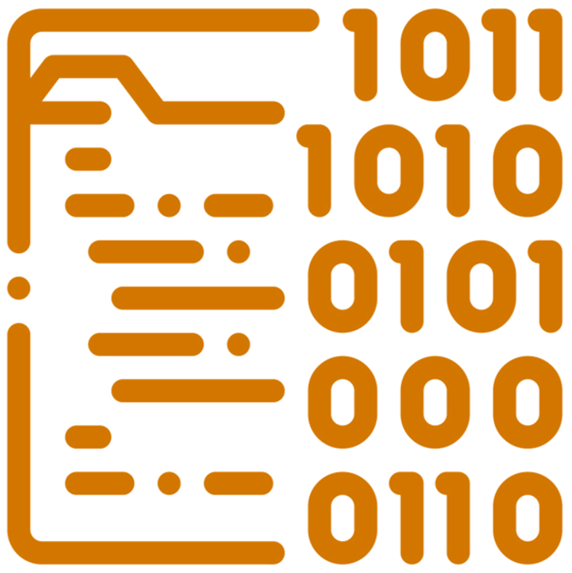
Data Types
Data Types in C#, Java, JS and Python

Slide 12
Primitive Data Types in C# and Java
Built-in data types in C#
Integer – int, long
Real number – double, float
Text – string, char
Boolean – bool
Other – object
Built-in data types in Java
Integer – int, long
Real number – double, float
Text – String, char
Boolean – boolean
Other – Object
int size = 50;
((Object)size).getClass() → Integer
int size = 50;
size.GetType() → Int32

Slide 13
Data Types in JavaScript
In JS data types are inferred from the values
Not explicitly specified at variable declaration
Primitive data types:
number
string
boolean
object
null
undefined
let size = 50;
typeof(size) → number
let name = "Peter";
typeof(name) → string
let arr = [3, 5, 8];
typeof(arr) → object

Slide 14
Data Types in Python
In Python variables keep values of certain type
The data type is inferred from the value
Built-in data types in Python:
int
float
str
boolean
list
size = 50;
type(size) → int
name = "Peter"
type(name) → str
values = [2, 3, 4]
type(values) → list

Slide 15
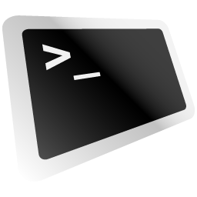
Printing on the Console
Printing Data in C#, Java, JS and Python

Slide 16
Printing on the Console in C#
Printing content and then going to a new line
Printing content and staying on the same line
Printing with formatting
Console.WriteLine("Peter");
Console.Write(" and Maria");
string name = "Maria";
int age = 25;
Console.WriteLine(
$"{name} is {age} years old.");

Slide 17
Printing on the Console in Java
Printing content and then going to a new line
Printing content and staying on the same line
Printing with formatting
System.out.println("Peter");
System.out.print(" and Maria");
String name = "Maria";
int age = 25;
System.out.printf(
"%s is %d years old.", name, age);

Slide 18
Printing on the Console in JavaScript
Printing content and then going to a new line
Printing content and staying on the same line
Printing with formatting
console.log("Peter");
process.stdout.write("and Maria");
Works only at the server-side
let name = "Maria";
let age = 25;
console.log(
`${name} is ${age} years old.`);

Slide 19
Printing on the Console in Python
Printing content and then going to a new line
Printing content and staying on the same line
Printing with formatting
print("Peter");
print("and Maria", end='');
name = "Maria";
age = 25;
print(
f'{name} is {age} years old.');

Slide 20
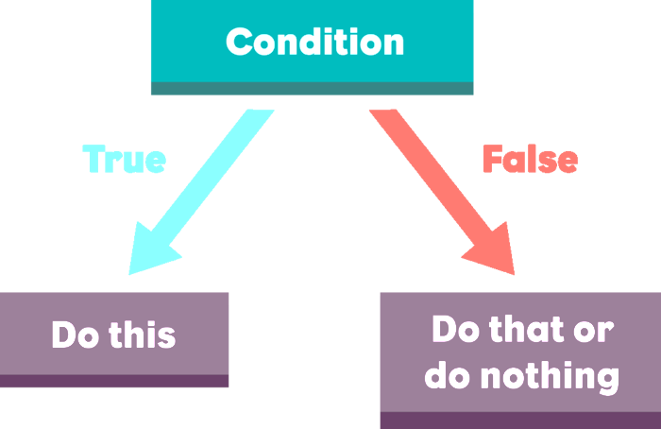
Conditional Statements
If-Else Statements in C#, Java, JS and Python

Slide 21
If-Else Statements in C# and Java
If-Else in C#
If-Else in Java
double grade = 4.50;
if (grade >= 3.00)
{
Console.WriteLine("Passed!");
}
else
{
Console.WriteLine("Failed!");
}
double grade = 4.50 if (grade >= 3.00) {
System.out.println("Passed!");
} else {
System.out.println("Failed!");
}

Slide 22
If-Else in JavaScript and Python
If-Else in JavaScript
If-Else in Python
let grade = 4.50;
if (grade >= 3.00) {
console.log("Passed!");
} else {
console.log("Failed!");
}
grade = 4.50
if grade >= 3.00:
print("Passed!")
else:
print("Failed!")

Slide 23

Loops
Loops in C#, Java, JS and Python

Slide 24
While Loop in C# and Java
While loop in C#
While loop in Java
int counter = 0;
while (counter <= 9)
{
Console.WriteLine(counter);
counter++;
}
int counter = 0;
while (counter <= 9) {
System.out.println(counter);
counter++;
}

Slide 25
While Loop in JS and Python
While loop in JS
While loop in Python
let counter = 0;
while (counter <= 9) {
console.log(counter);
counter++;
}
counter = 0
while counter <= 9:
print(counter)
counter += 1

Slide 26
For Loop in C# and Java
For-loop in C#
For-loop in Java
for (int i = 0; i <= 9; i++)
{
Console.WriteLine(i);
}
for (int i = 0; i <= 9; i++) {
System.out.println(i);
}

Slide 27
For Loop in JS and Python
For-loop in JS
For-loop in Python
for (let i = 0; i <= 9; i++) {
console.log(i);
}
for i in range(0, 10):
print(x)

Slide 28




IDE
Integrated Development Environments

Slide 29

Most Popular IDE for C#
Visual Studio

Slide 30
Most Popular IDE for Java
IntelliJ IDEA

Slide 31

Most Popular IDE for JavaScript
Visual Studio Code

Slide 32

Most Popular IDE for Python
PyCharm

Slide 33

Universal Online IDEs
REPL.it
Online IDE for C#, Java, JS, Python and many others

Slide 34
Questions?
Notes:
34

Slide 35











SoftUni Diamond Partners

Slide 36



Educational Partners

Slide 37
Trainings @ Software University (SoftUni)
Software University – High-Quality Education, Profession and Job for Software Developers
softuni.bg, about.softuni.bg
Software University Foundation
softuni.foundation
Software University @ Facebook
facebook.com/SoftwareUniversity
Software University Forums
forum.softuni.bg
Notes:
37

Slide 38

License
This course (slides, examples, demos, exercises, homework, documents, videos and other assets) is copyrighted content
Unauthorized copy, reproduction or use is illegal
© SoftUni – https://about.softuni.bg/
© Software University – https://softuni.bg
Notes:
38

